Slide 1

Natural Language Processing
Rohit Kate
Word Embeddings – Part 2

Slide 2
Evaluation of Word Embeddings
How should one evaluate word embeddings once obtained?
Indirectly: Use in an NLP task and see what type of performance they lead to
Directly: Evaluate them on word similarity related tasks
There are multiple ways to do it

Slide 3
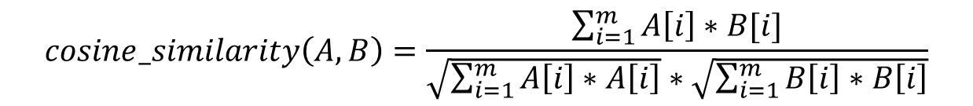
Semantic Similarity
Besides distance, semantic similarity can also be measured as the cosine similarity
Cosine similarity is computed as the normalized dot product of the vector components
$$cosine_similarity\left(A,B\right)=\frac{\sum_{i=1}^{m}{A\left[i\right]∗B[i]}}{\sqrt{\sum_{i=1}^{m}{A\left[i\right]∗A\left[i\right]}}∗\sqrt{\sum_{i=1}^{m}{B\left[i\right]∗B\left[i\right]}}}$$

Slide 4
Semantic Similarity
It is cosine of the inner angle between two vectors that extend from the origin of the space
Independent of the magnitude of the vectors
Similar vectors have large cosine similarity (cos(0)=1).
B
cosine_similarty(A,B)=cos(θ)
θ
A
(0,0)

Slide 5
Evaluation of Word Embeddings
Have humans rate (1-10) the semantic similarity of a large set of word pairs
For example: (dog, canine): 10; (dog, cat): 7; (bottle, carrot): 3; (saw, knife): 8
Then compute similarity scores as obtained using word embeddings (e.g. cosine similarity between word vectors of “dog” and “canine”)
Compute correlation coefficient (e.g. Pearson) between human and word embedding ratings
Close to 1 means word embeddings are good
Close to 0 means word embeddings are poor

Slide 6
Evaluation of Word Embeddings
Word Pair | Human-rated similarity | Similarity from word embeddings
(dog, canine) | 10 | 9.2
(dog, cat) | 7 | 8.1
(bottle, carrot) | 3 | 3.2
(saw, knife) | 8 | 5.6
… | … | …
Correlation coefficient

Slide 7
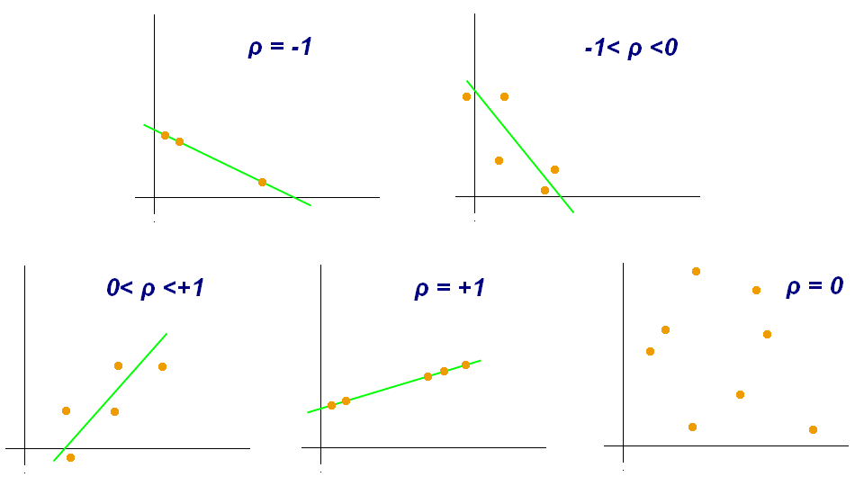
Pearson Correlation Coefficient
Measures the degree of linearity between two sets of numbers
Varies from -1 (linear decreasing) to 1 (linear increasing); 0 => no correlation

Slide 8
TOEFL Synonymy Test
TOEFL: Test of English as a Foreign Language (standardized test)
Some TOEFL questions ask you to find the most similar word to a given word
Detest:
Hate
Argue
Discover
Reveal
Word embeddings have been shown to do well on such questions

Slide 9
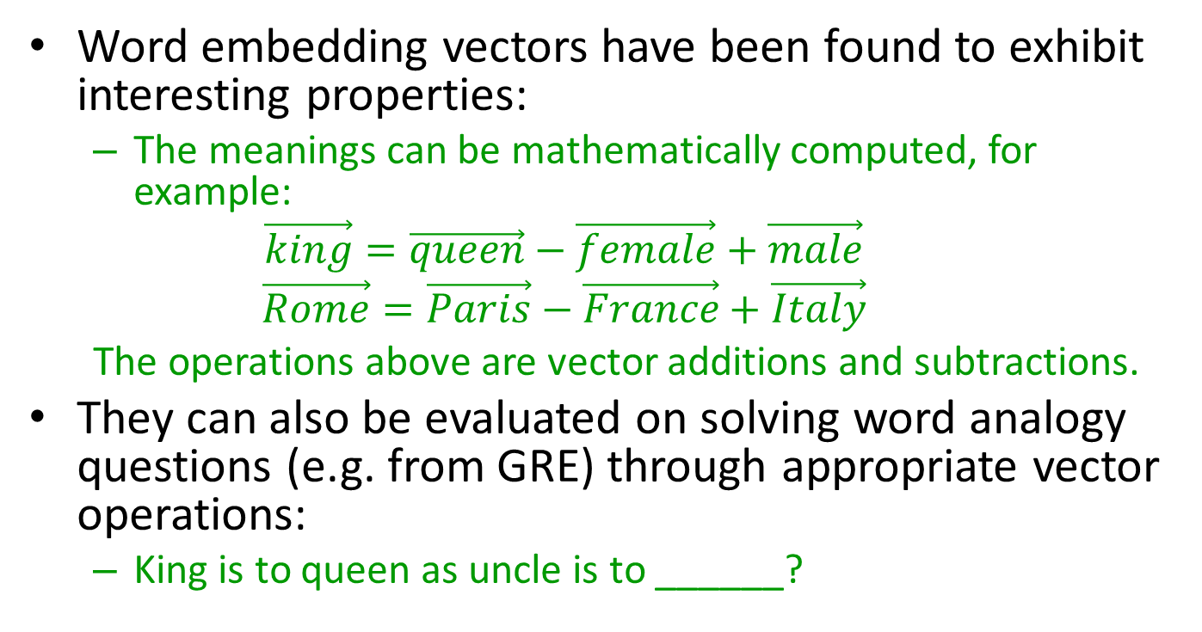



Analogy Tests
Word embedding vectors have been found to exhibit interesting properties:
The meanings can be mathematically computed, for example:
$$\vec{king}=\vec{queen}−\vec{female}+\vec{male}$$
$$\vec{Rome}=\vec{Paris}−\vec{France}+\vec{Italy}$$
The operations above are vector additions and subtractions.
They can also be evaluated on solving word analogy questions (e.g. from GRE) through appropriate vector operations:
King is to queen as uncle is to ______?
$$\vec{queen}=\vec{king}−\vec{male}+\vec{female}$$
$$\vec{aunt}=\vec{uncle}−\vec{male}+\vec{female}$$
Hence:
$$\vec{aunt}=\vec{uncle}−\vec{king}+\vec{queen}$$

Slide 10
Visualizing Embeddings
Besides testing embeddings, it is sometimes desirable to take a look at embeddings
It is not possible to do directly because of high dimensions
Dimensionality reduction techniques can be used to first reduce dimensions
PCA (principal component analysis)
ICA (independent component analysis)
t-SNE (tee-snee: t-distributed Stochastic Neighbor Embedding; preserves neighbors while reducing dimensions)

Slide 11
Visualizing Embeddings
Sample visualization:
Figure 3.12 from Textbook 1

Slide 12
Out of Vocabulary (OOV) Problem
Word embedding methods can only learn embeddings for the words given during training
What if you encounter a word during testing which was never seen during training? E.g. doggy
Known as Out of Vocabulary (OOV) problem
Previously unseen words are called OOV words

Slide 13
Handling OOV Problem
Word orthography (spelling) relates to the meanings of the words
Words spelled similarly are often related (e.g. legal, legally, illegal)
Can we learn embeddings at a level smaller than words (subwords)?
fastText method uses subword information
Reduces a word to a sequence of n-length characters (where n is a parameter)
Special symbols to indicate start and end of words
doggy (n=3) → <STARTdo, dog, ogg, ggy, gyEND>
Uses a skip-gram like architecture and learns embeddings of these subwords
Vector of “doggy” will be the sum of the subword vectors
More recent methods decide subwords based on their frequencies instead of constant length of characters

Slide 14
Compositional Vector Semantics
Compute vector meanings of phrases and sentences by combining (composing) the vector meanings of its words
Simplest approach is to use vector addition or component-wise multiplication to combine word vectors
Evaluate on human judgements of phrase or sentence-level semantic similarity
Disadvantages:
Word order is completely ignored
“the dog bit the man” and “the man bit the dog” will have the same sentence embedding!
Simple hack, not principled

Slide 15
“Document”-Level Embeddings
Alternate methods have been proposed to get embeddings for multiple words
Methods: Sentence2Vec, Paragraph2Vec, Doc2Vec, paragraph vectors
They are variations of the same idea
“Document” means any variable length text containing multiple words

Slide 16
“Document”-Level Embeddings
Distributed memory model of paragraph vectors (PV-DM), a Doc2Vec model
Similar to CBOW but with one additional vector called paragraph vector
The model predicts the target words from the context words and the paragraph vector
Each paragraph is assigned an id
Only previous words are used as context (a minor difference)
Model learns representation (embedding) for each paragraph as it tries to maximize prediction accuracy

Slide 17
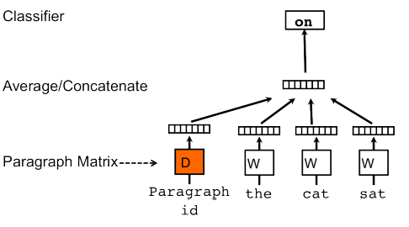
“Document”-Level Embeddings
Image from: https://cs.stanford.edu/~quocle/paragraph_vector.pdf

Slide 18
Word Embeddings for NLP
The learned word embeddings can be used to represent words to give as input to neural networks for various natural language processing (NLP) tasks
Text or sentence classification
Machine translation
Part-of-speech tagging
…
However, words in text are in a sequence hence the neural network should be able to work with sequences of input
Later in the course

Slide 19
Drawbacks of Word Embeddings
The antonyms tend to get similar vectors even though their meanings are exactly the opposite, e.g. “good” and “bad”
This is not surprising because one will see the antonyms in similar contexts, e.g. “good cat”, “good dog”, “bad cat”, “bad dog”, etc.
Word embeddings do not handle polysemous words (words that can have multiple meanings or senses) well
For example, “bat” can mean sports bat as well as the mammal bat; the word embedding methods will tend to learn a vector for “bat” that falls between those two meanings

Slide 20
More Recently
Newer methods have been developed that
Give context-based embeddings
Can give embeddings for multiple-words or sentences
Learn or adapt embeddings specific for a task
We will get to these methods later in the course
These embeddings still have disadvantages, e.g. antonyms

